Slide 1
Wireless Communications
Principles and Practice
T.S. Rappaport
2nd Edition
Chapter 2: Modern Wireless Communication Systems

Slide 2
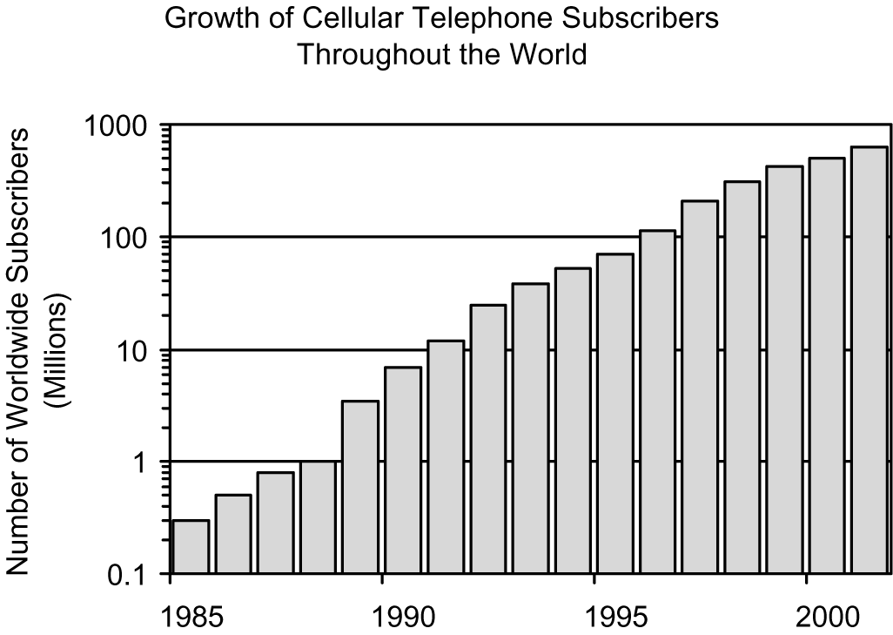
Figure 2.1 Growth of cellular telephone subscribers throughout the world.
Notes:
Fig. 2.1

Slide 3
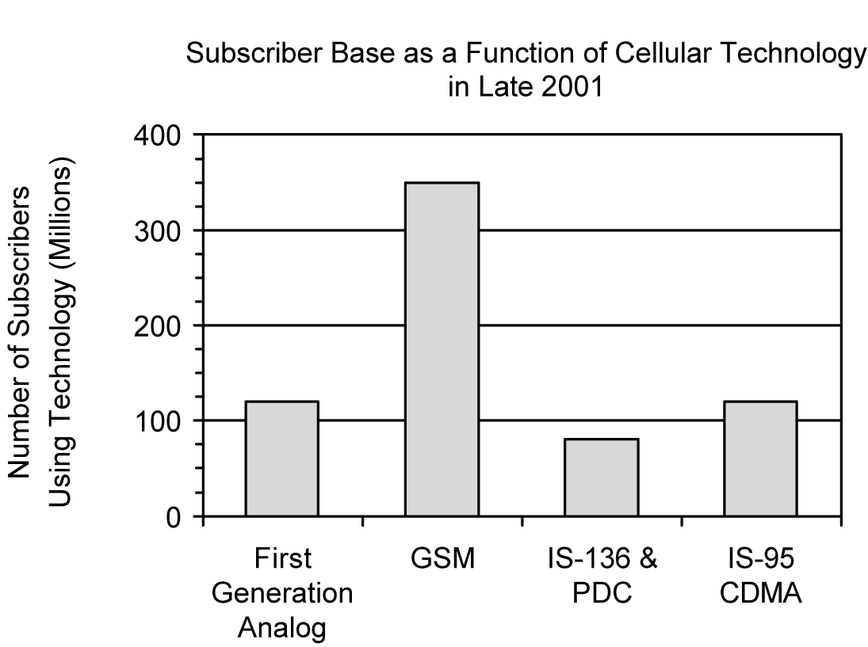
Figure 2.2 Worldwide subscriber base as a function of cellular technology in late 2001.
Notes:
Fig. 2.2

Slide 4
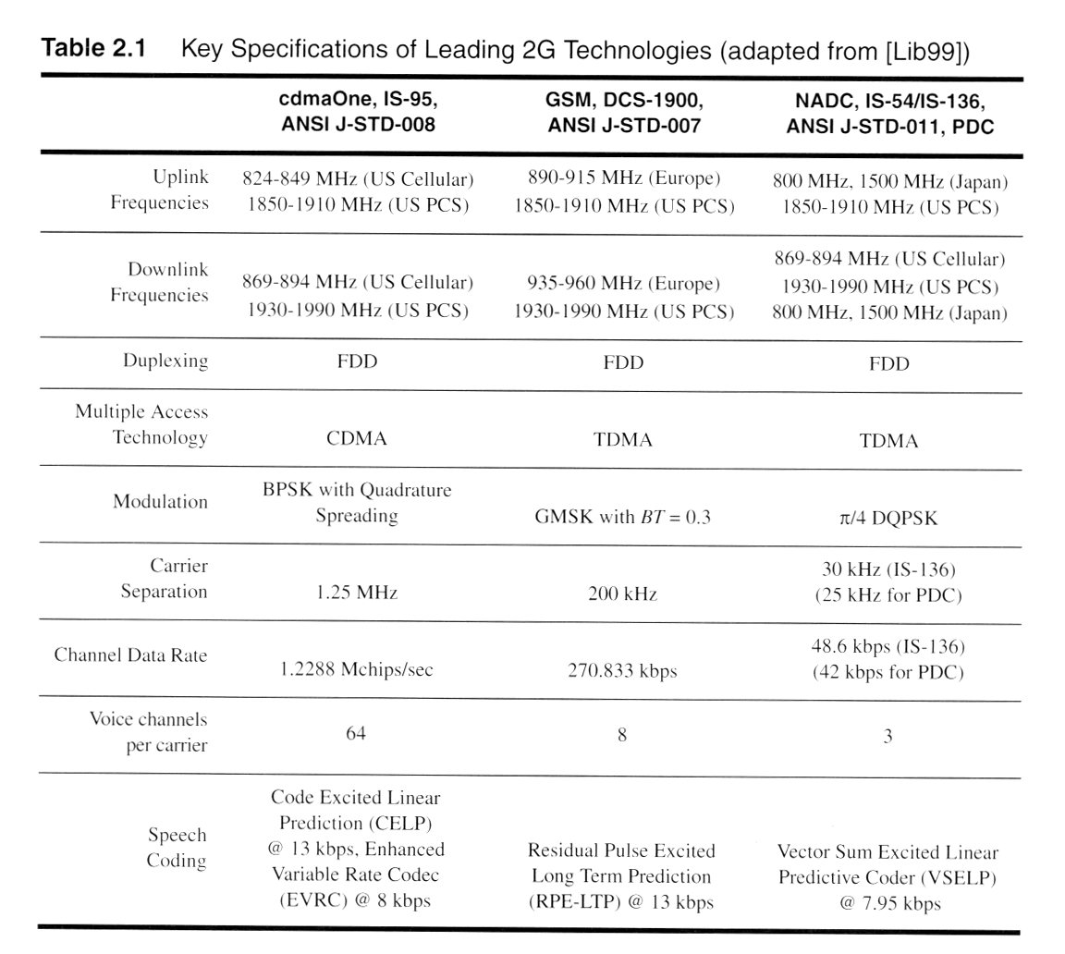

Slide 5
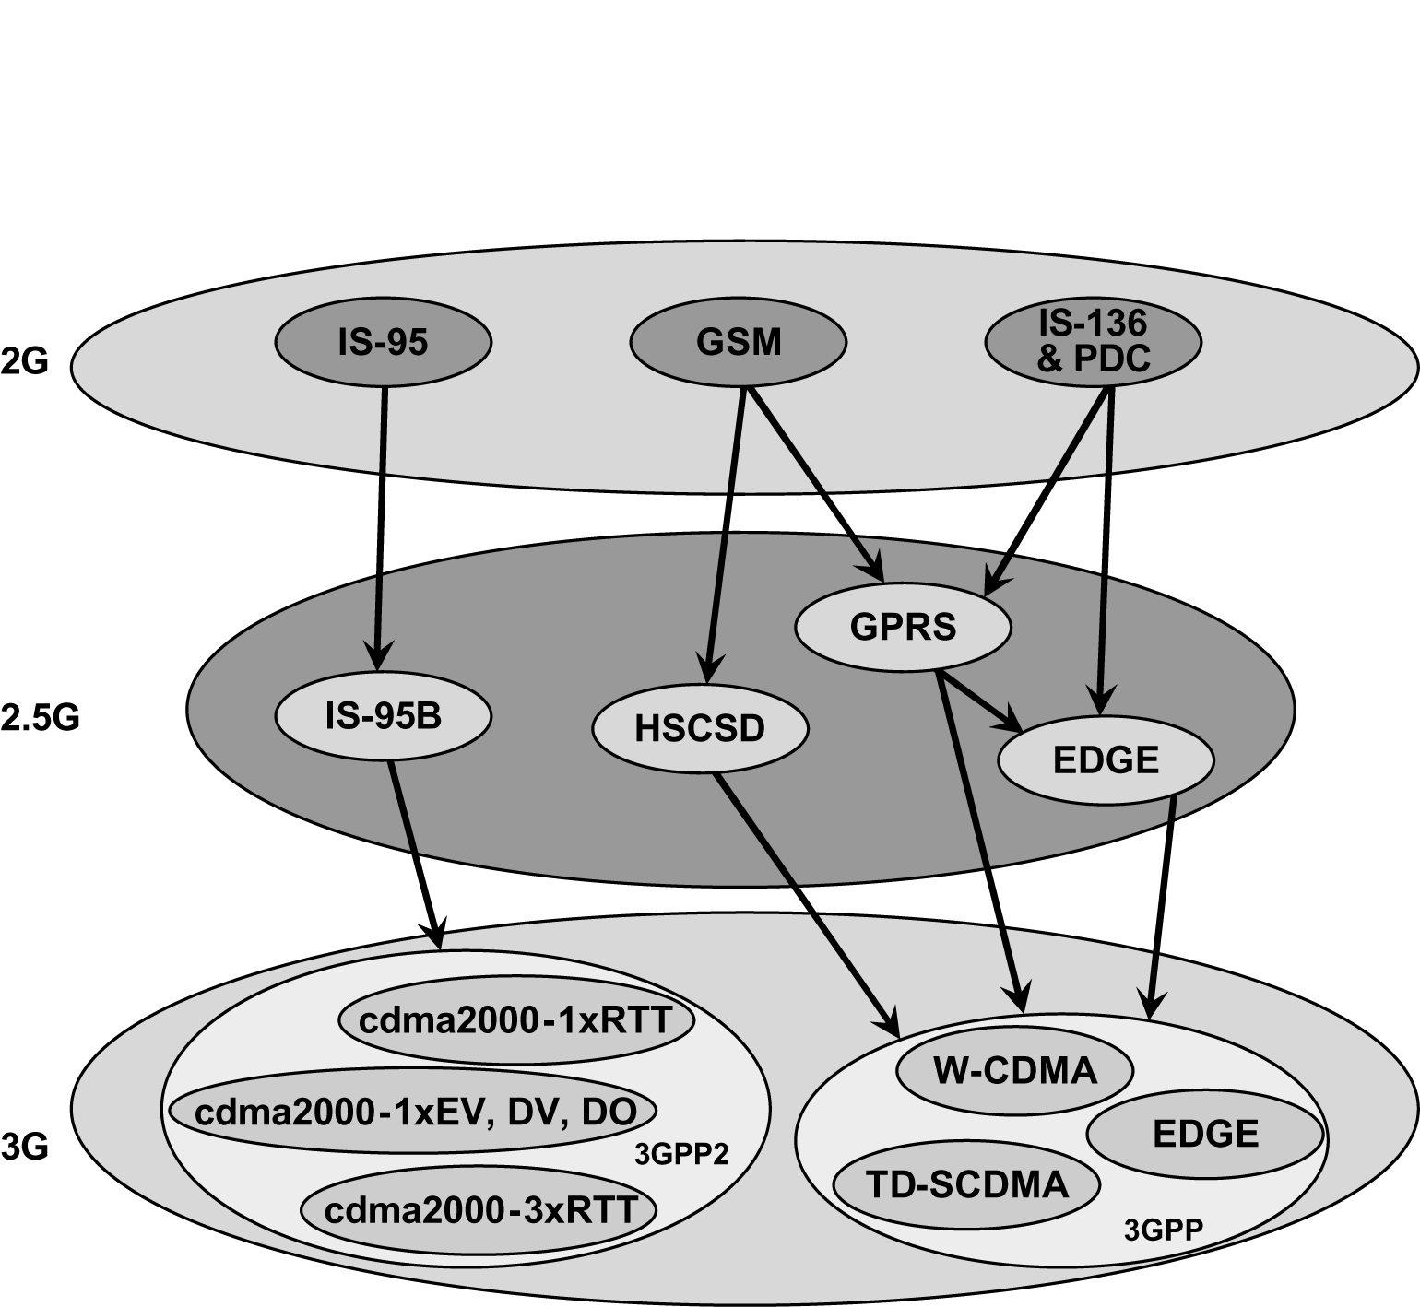
Figure 2.3 Various upgrade paths for 2G technologies.
Notes:
Fig. 2.3

Slide 6
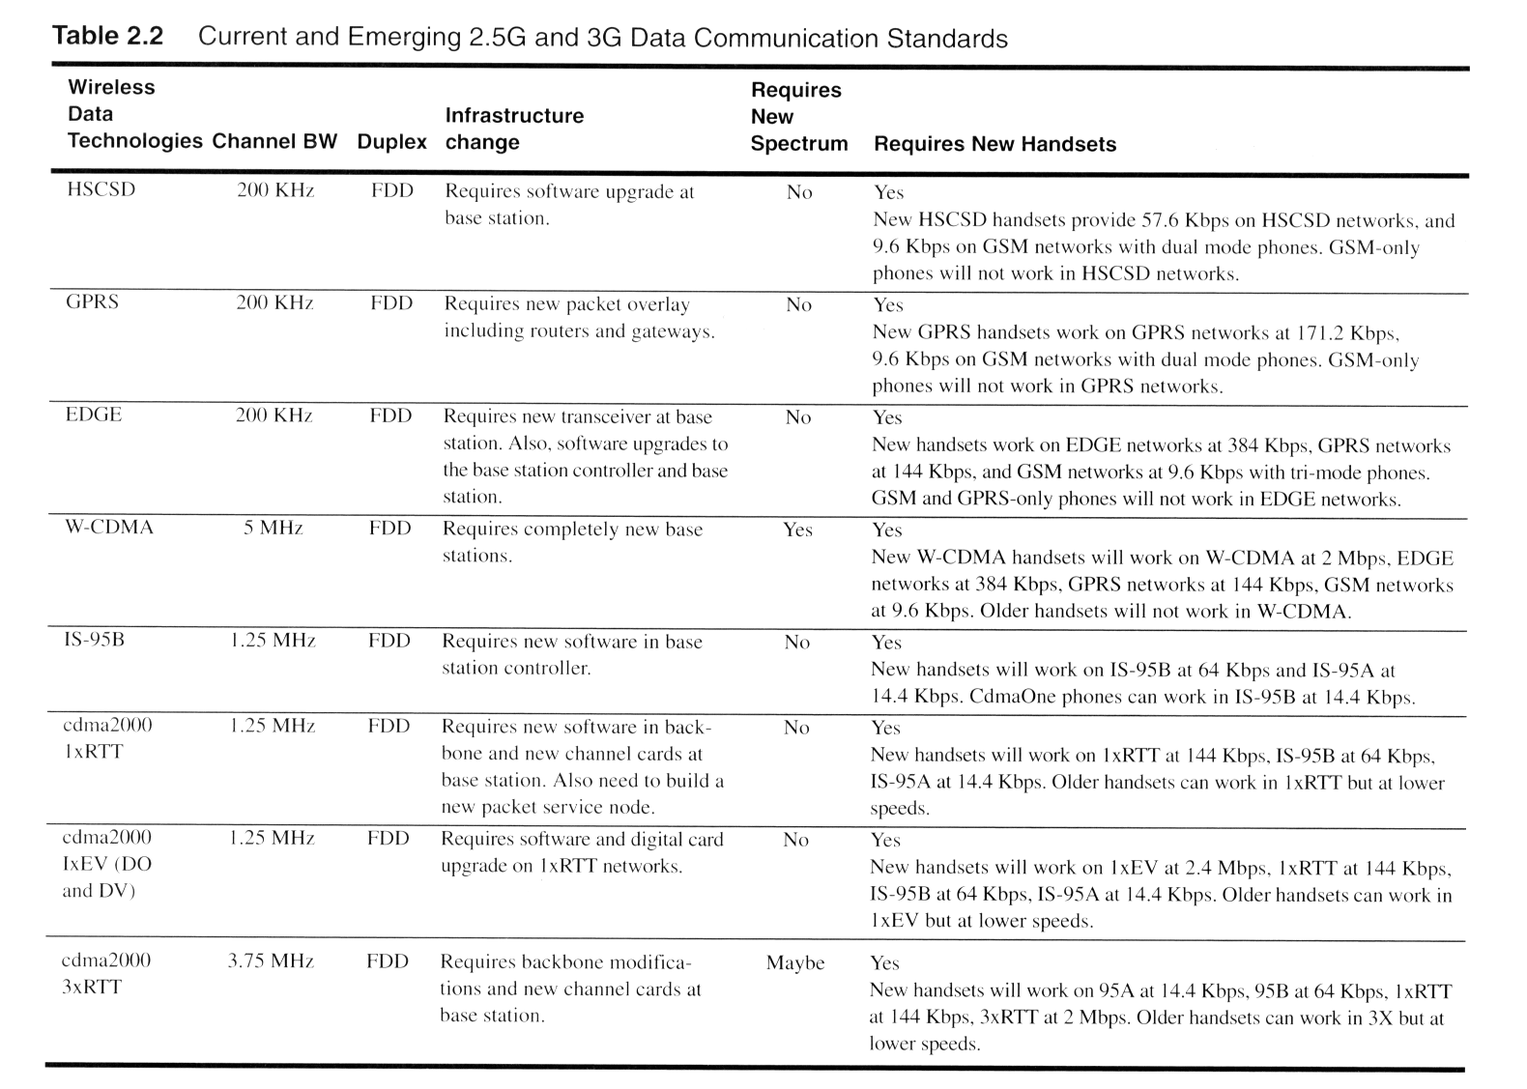

Slide 7
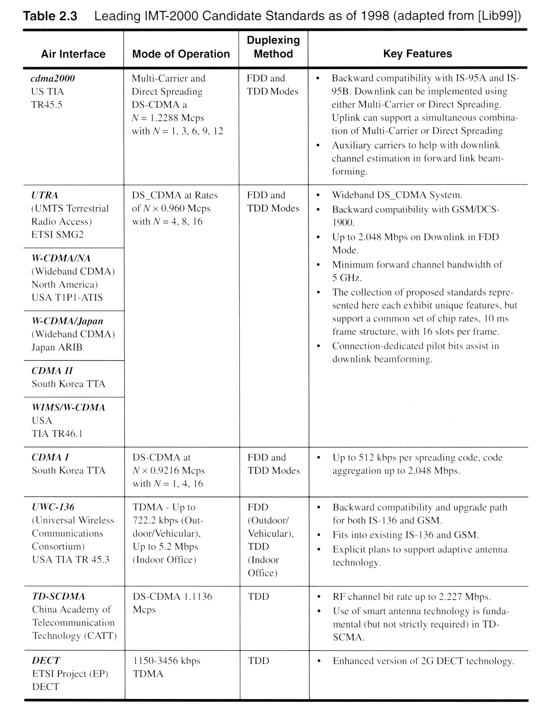

Slide 8
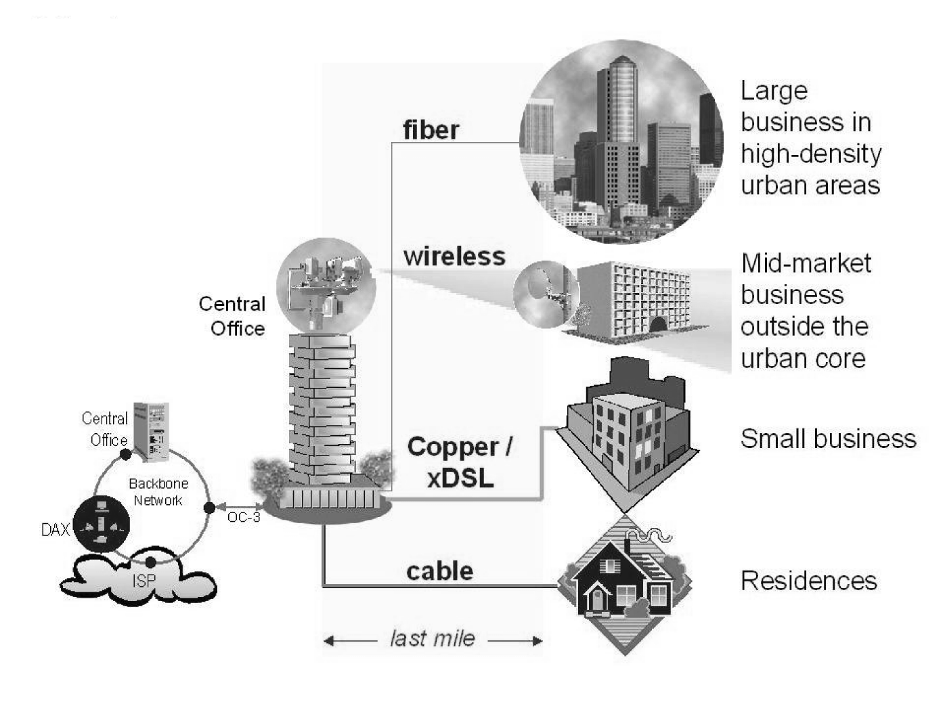
Figure 2.4 Example of the emerging applications and markets for broadband services. (Courtesy of Harris Corporation, ©1999, all rights reserved.)
Notes:
Fig. 2.4

Slide 9
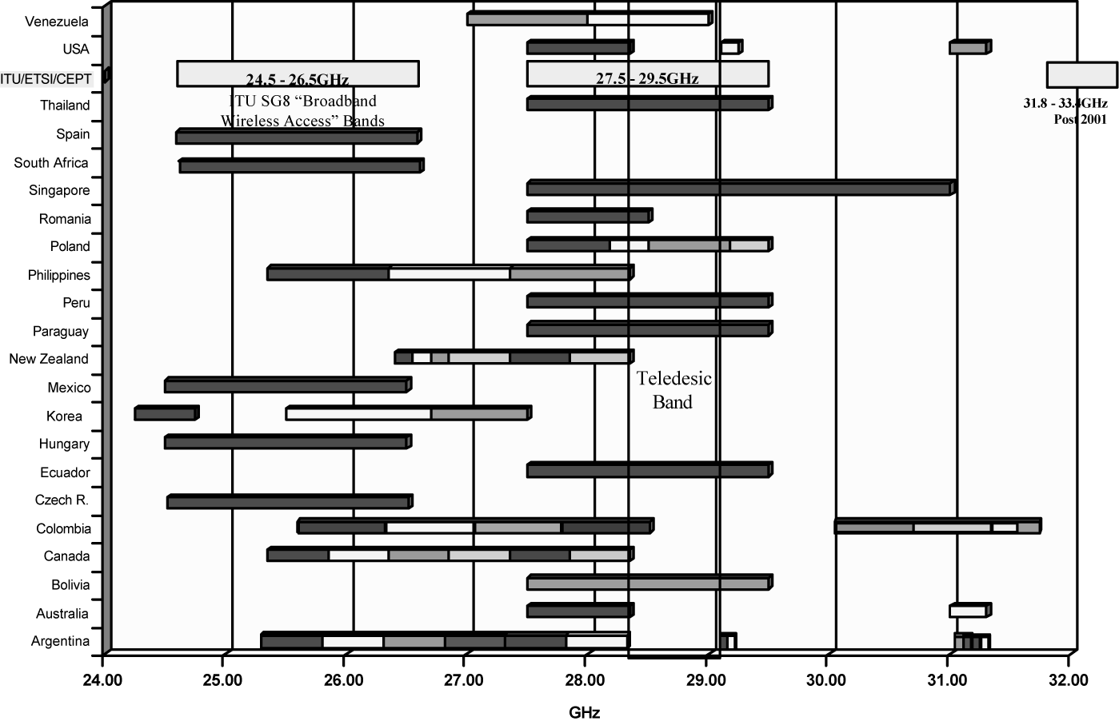
Figure 2.5 Allocation of broadband wireless spectrum throughout the work. (Courtesy of Ray W. Nettleton and reproduced by permission of Formus Communications.)
Notes:
Fig. 2.5

Slide 10
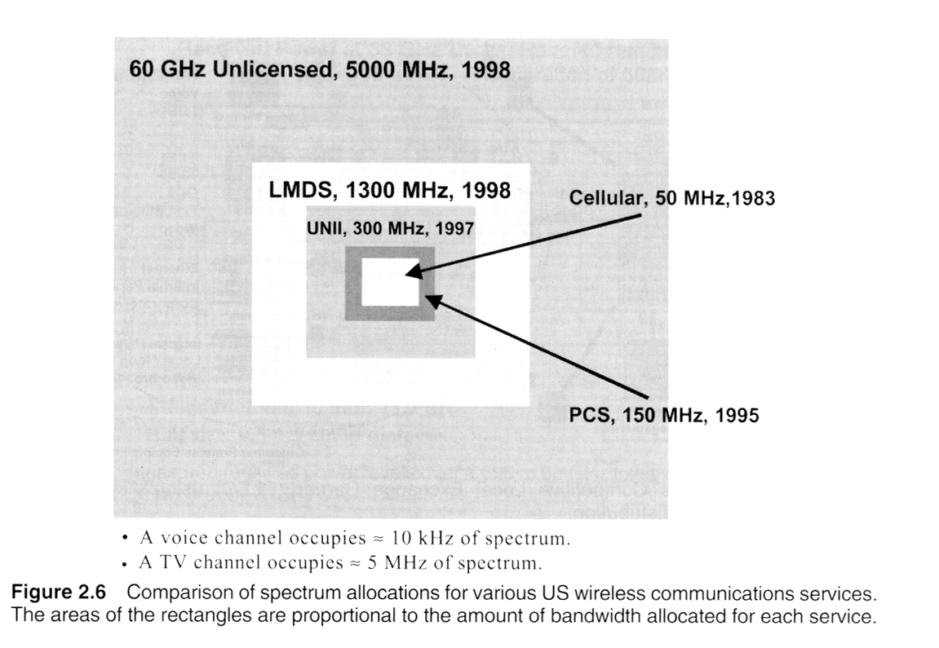
Notes:
Fig. 2.6

Slide 11
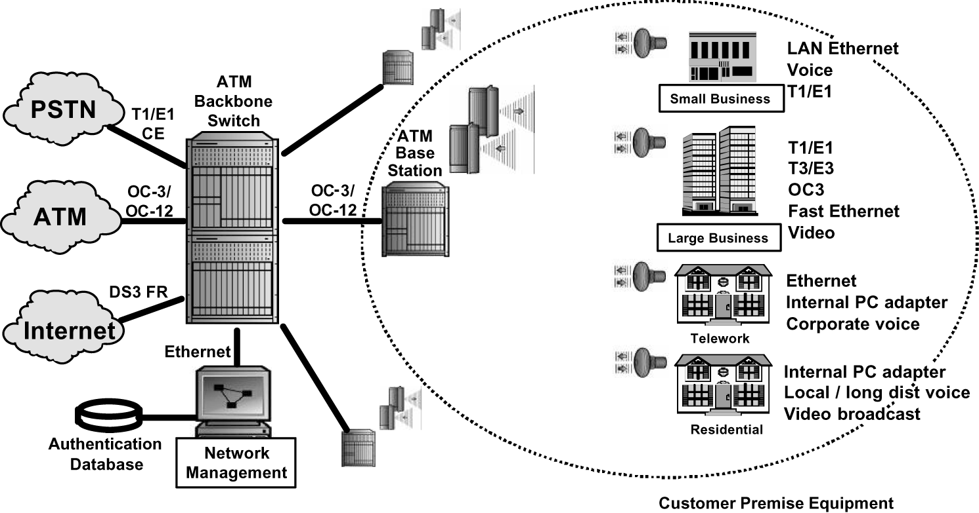
Figure 2.7 A wireless Competitive Local Exchange Carrier (CLEC) using Asynchronous Transfer Mode (ATM) distribution.
Notes:
Fig. 2.7

Slide 12
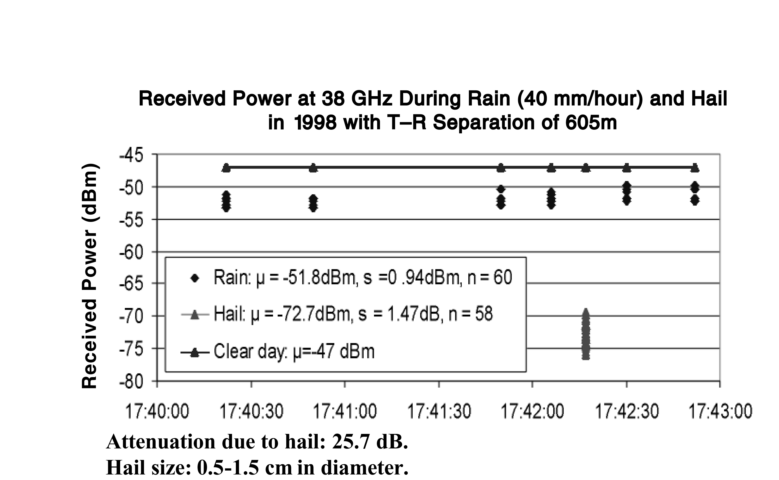
Figure 2.8 Measured received power levels over a 605 m 38 GHz fixed wireless link in clear sky, rain, and hail [from [Xu00], ©IEEE].
Notes:
Fig. 2.8

Slide 13
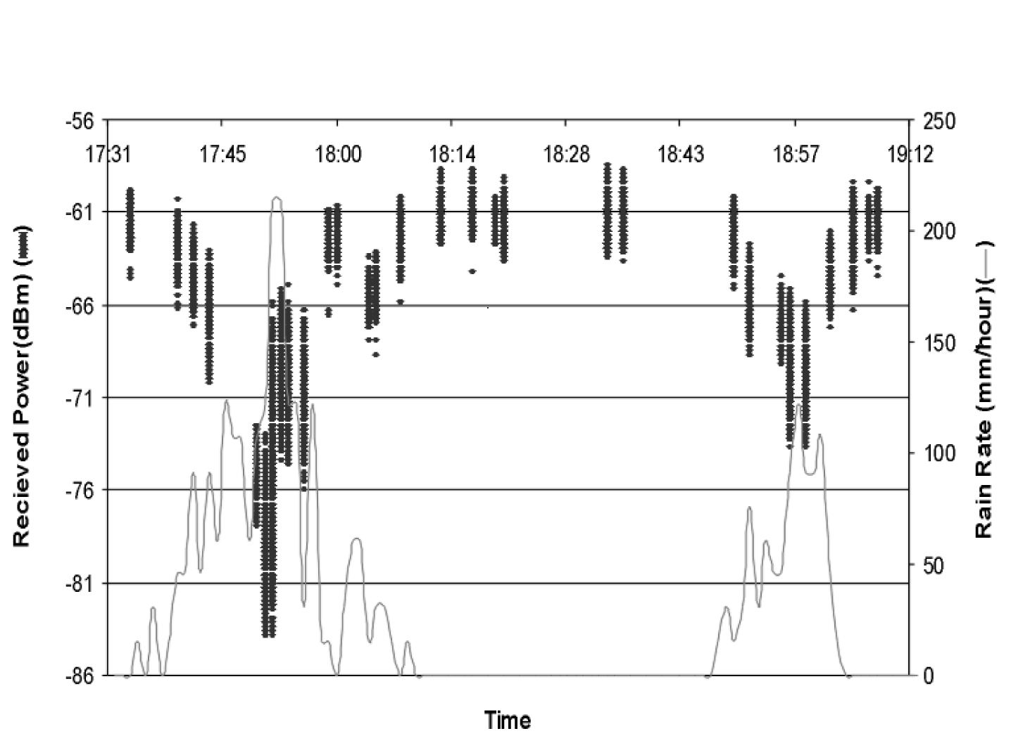
Figure 2.9 Measured received power during rain storm at 38 GHz [from [Xu00], ©IEEE].
Notes:
Fig. 2.9

Slide 14
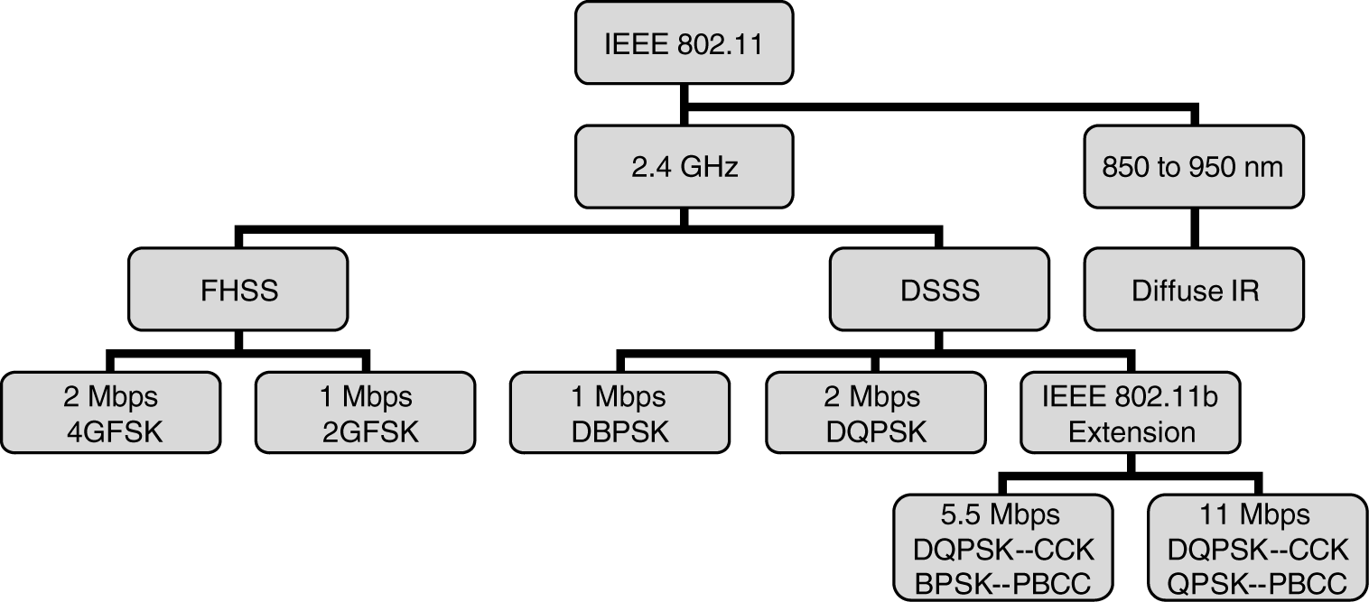
Figure 2.10 Overview of the IEEE 802.11 Wireless LAN standard.
Notes:
Fig. 2.10

Slide 15
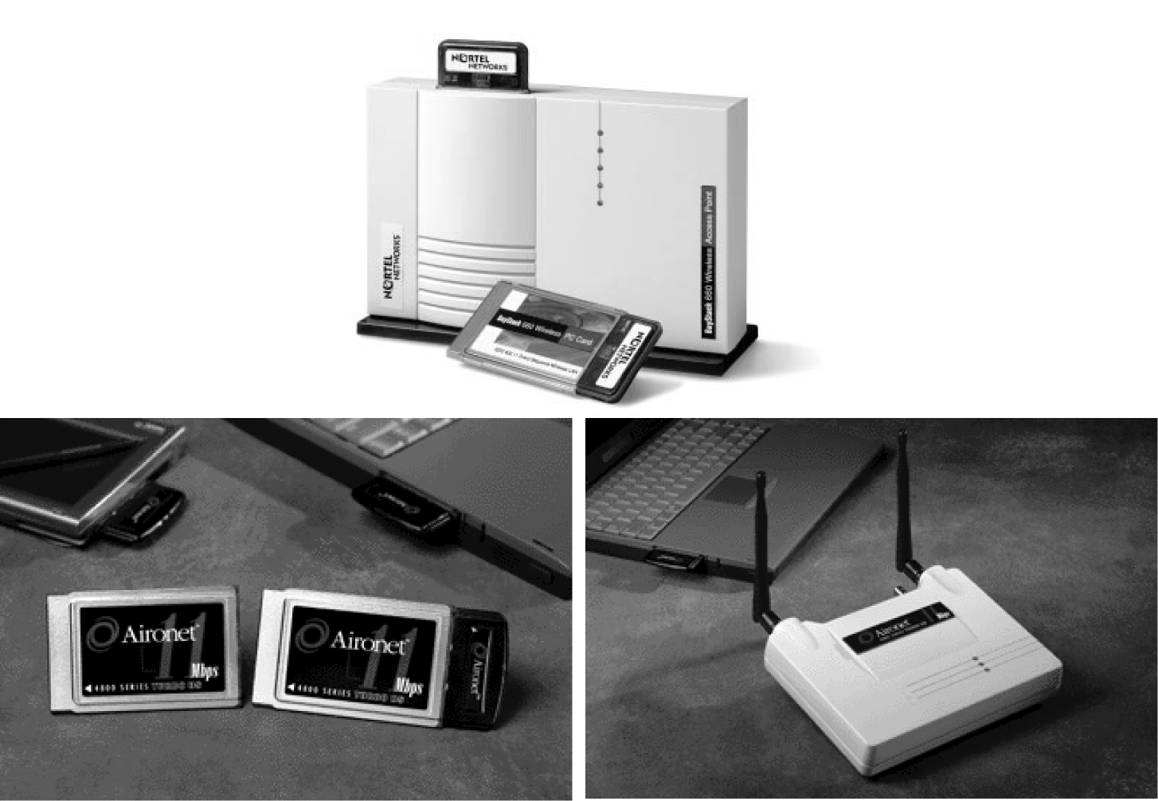
Figure 2.11 Photographs of popular 802.11b WLAN equipment. Access points and a client card are shown on left, and PCMCIA Client card is shown on right. (Courtesy of Cisco Systems, Inc.)
Notes:
Fig. 2.11

Slide 16
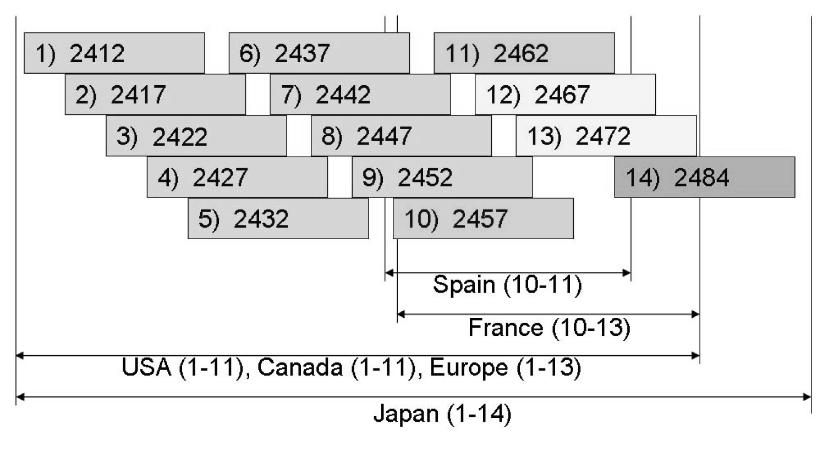
Figure 2.12 Channelization scheme for IEEE 802.11b throughout the world.
Notes:
Fig. 2.12

Slide 17
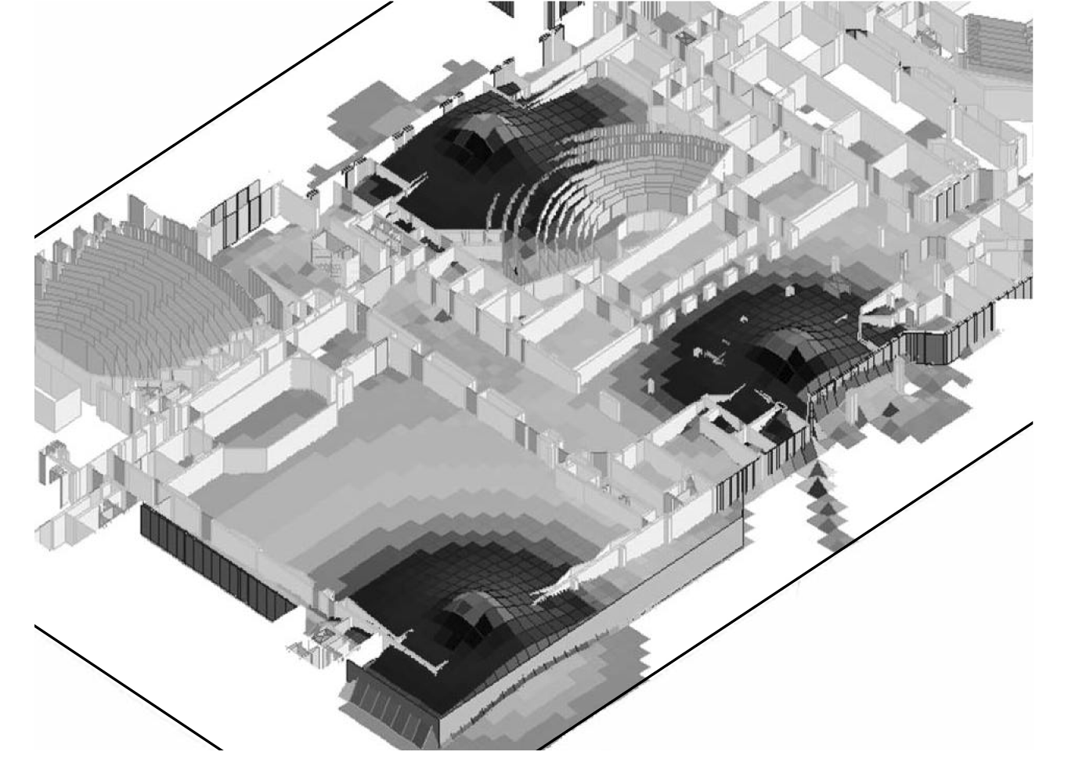
Figure 2.13 A predicted coverage plot for three access points in a modern large lecture hall. (Courtesy of Wireless Valley Communications, Inc., ©2000, all rights reserved.)
Notes:
Fig. 2.13

Slide 18
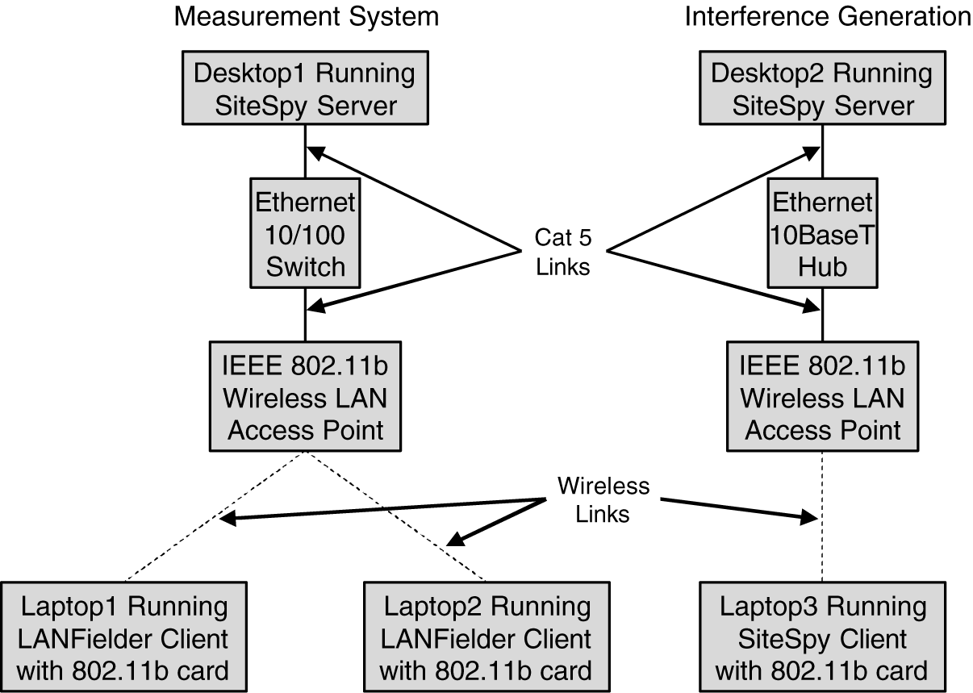
Figure 2.14 Schematic of an experiment to determine how received interference impacts end user performance on a WLAN network [Hen01] demonstrated that a CAD prediction and measurement environment can be used to accurately and rapidly predict true end user throughput in a multi-node network using blind prediction. Such capabilities will be vital as user densities increase in WLAN networks within buildings or campuses.
Notes:
Fig. 2.14

Slide 19
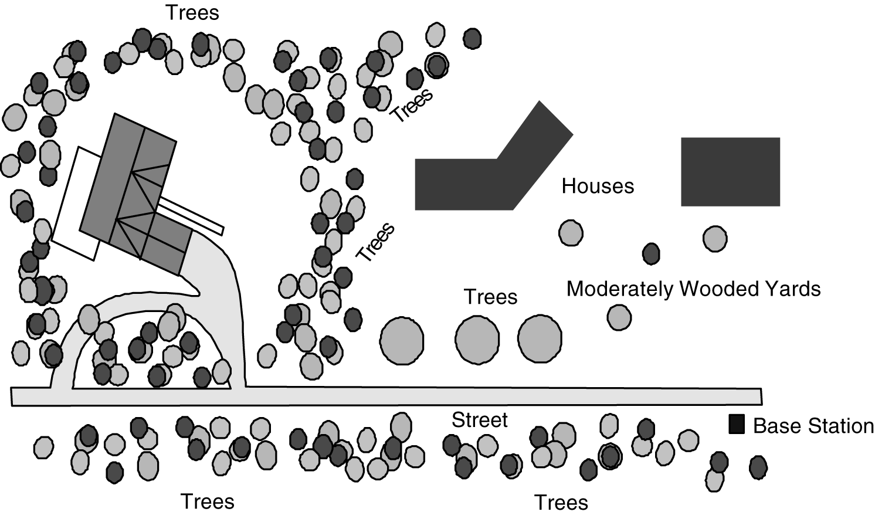
Figure 2.15 A typical neighborhood where high speed license free WLAN service from the street might be contemplated [Dur98b].
Notes:
Fig. 2.15

Slide 20
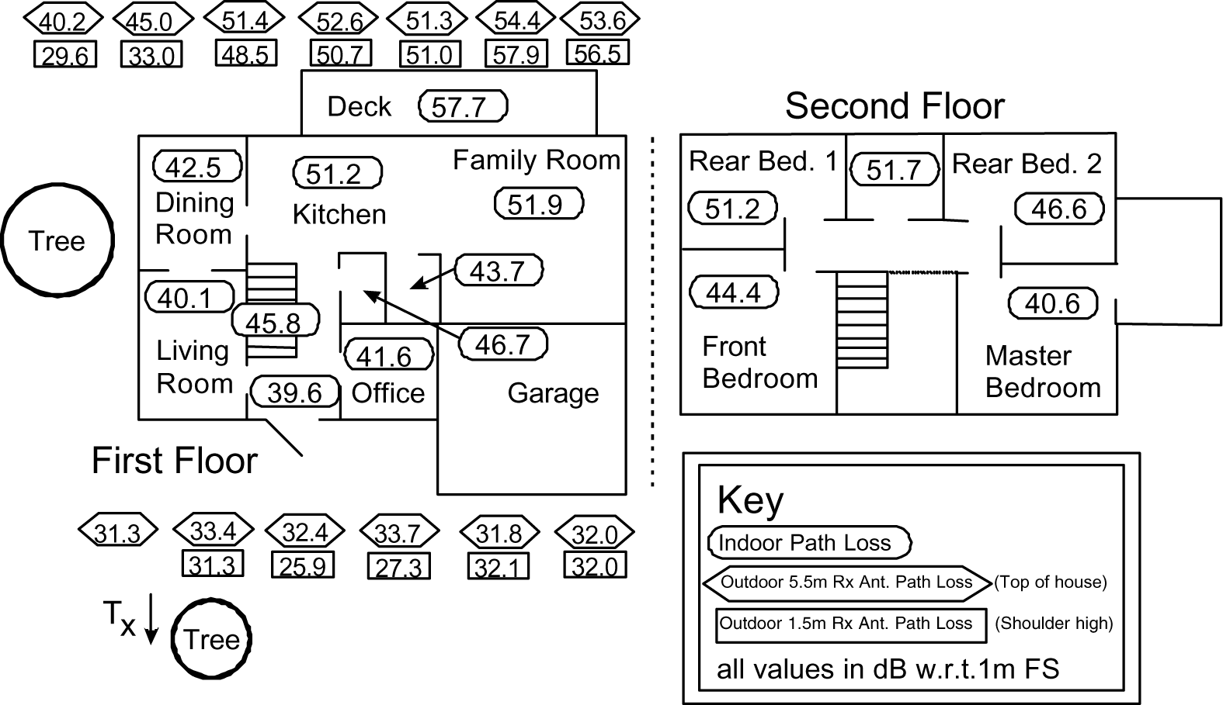
Figure 2.16 Measured values of path loss using a street-mounted lamp-post transmitter at 5.8 GHz, for various types of customer premise antenna [from [Dur98], ©IEEE].
Notes:
Fig. 2.16

Slide 21
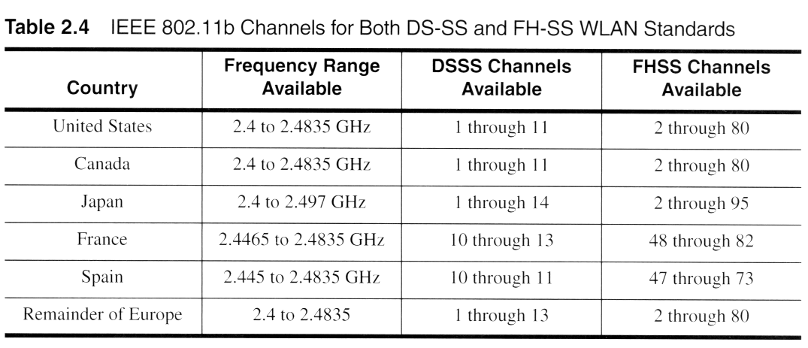

Slide 22
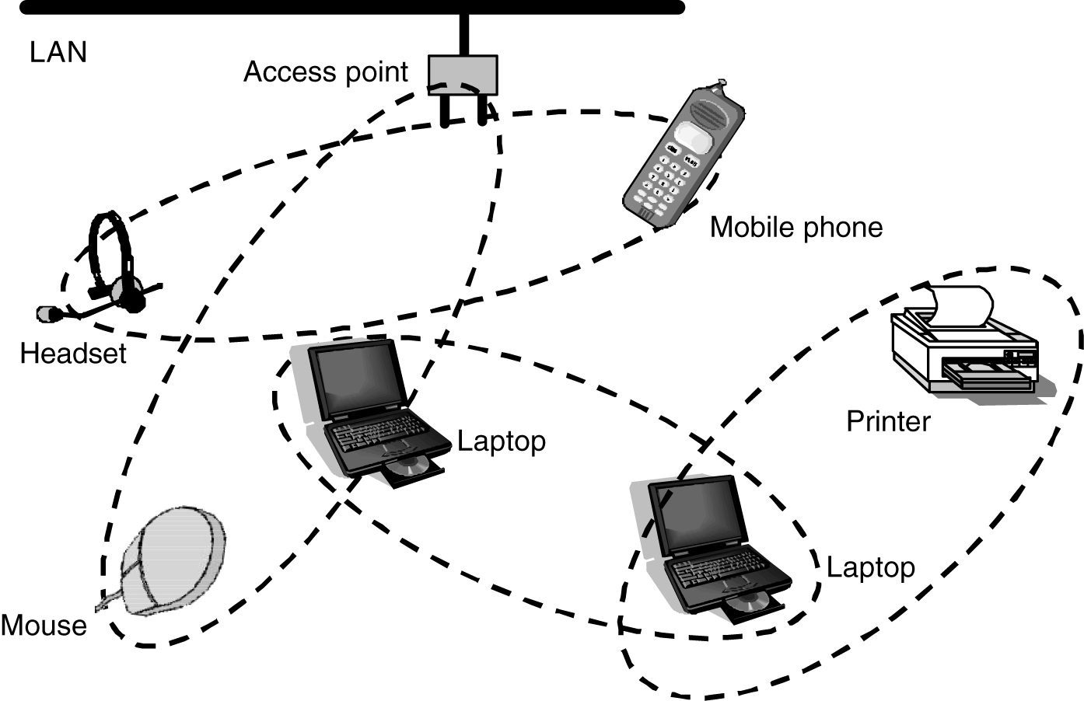
Figure 2.17 Example of a Personal Area Network (PAN) as provided by the Bluetooth standard.
Notes:
Fig. 2.17

